Slide 1
INVESTIGATION OF INERTIAL SUPPORT LIMITS IN WIND TURBINES AND THE EFFECTS ON THE POWER SYSTEM STABILITY
Erencan DUYMAZ
Supervisor: Assist. Prof. Dr. Ozan KEYSAN
Thesis Defence
For
The Degree of Master of Science
in Electrical and Electronics Engineering
Friday, January 18th, 2019

Slide 2
Agenda
Renewable Energy Status and Problems
Inertia, Frequency and Inertial Support in the Grid
Wind Turbine Modelling
Fast Inertial Support
Synthetic Inertia Support
Effects on Turkish Electricity System
Economical Perspective
Conclusion

Slide 3
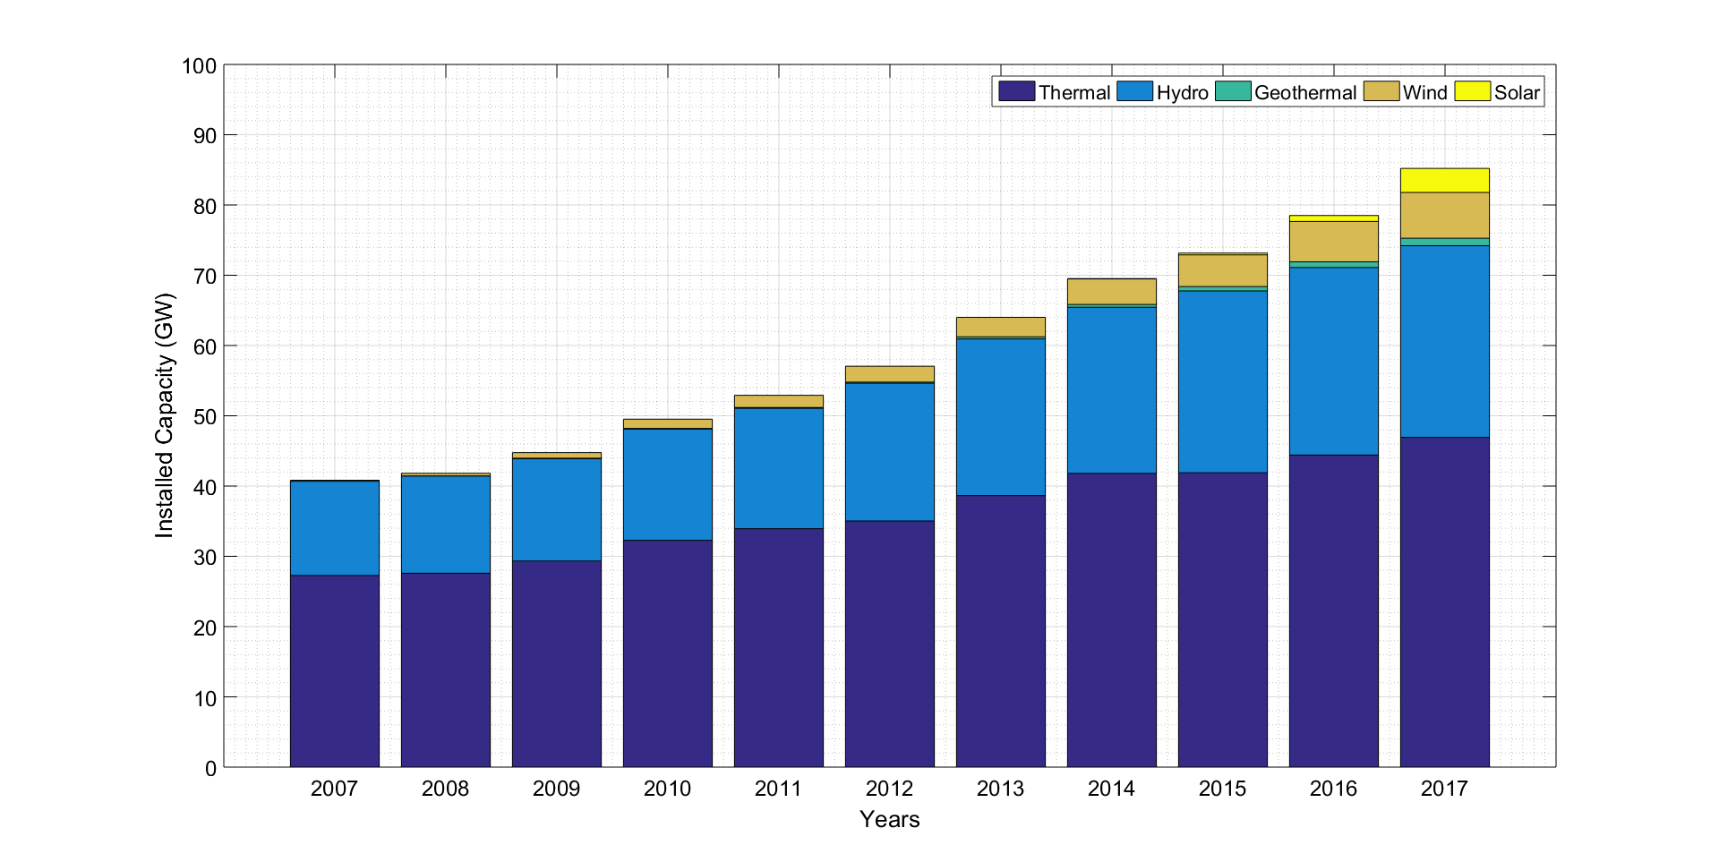
Renewable Energy Problems

Slide 4
Renewable Energy Problems
Benefits:
Fossil Fuel Usage
CO₂ Emission
Challanges:
Operational Problems
variable and uncontrolled nature of renewable sources
Reduction in Grid Inertia
existing control structure of the wind turbines

Slide 5
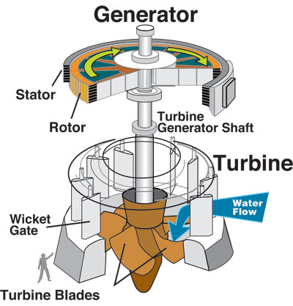
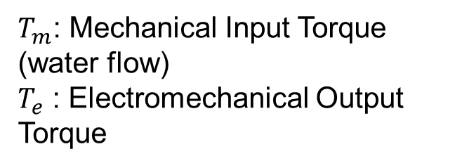

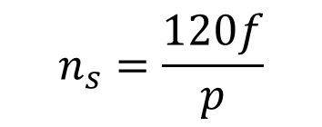
Synchronous Generator
$$n_{s}=\frac{120f}{p}$$
$$T_{m}−T_{e}=J\frac{dω}{dt}$$
$T_{m}$: Mechanical Input Torque (water flow)
$T_{e}$ : Electromechanical Output Torque
Notes:
Synchronous generators produces torque only in synchronous speed.
When they are sycnhronized to grid frequency, Tm=Te

Slide 6



Swing Equation
$$T_{m}−T_{e}=J\frac{dω}{dt}$$
$$H=\frac{\frac{1}{2}Jω^{2}}{S_{base}}$$
$$2H\overline{ω}\frac{d\overline{ω}}{dt}=Δ\overline{P}$$
Notes:
Swing Equation is important for power system frequency stability and investigates the relation between speed and the power. As the frequency decreases, generator slows down and this creates an increase in the active power output.

Slide 7
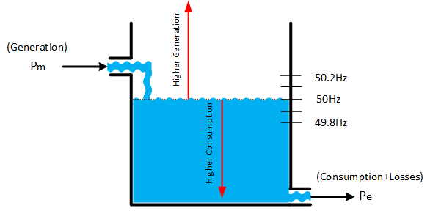
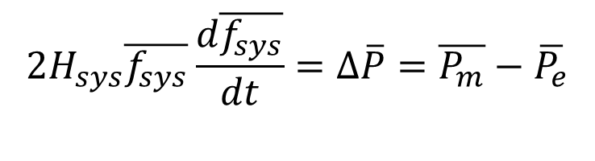
Frequency
Frequency Regulating Mechanisms in Grid:
Primary Frequency Control (no longer than 15s)
Secondary Control
Tertiary Frequency Control
$$2H_{sys}\overline{f_{sys}}\frac{d\overline{f_{sys}}}{dt}=Δ\overline{P}=\overline{P_{m}}−\overline{P_{e}}$$
Notes:
When all generators in the grid is considered as a single generator,

Slide 8
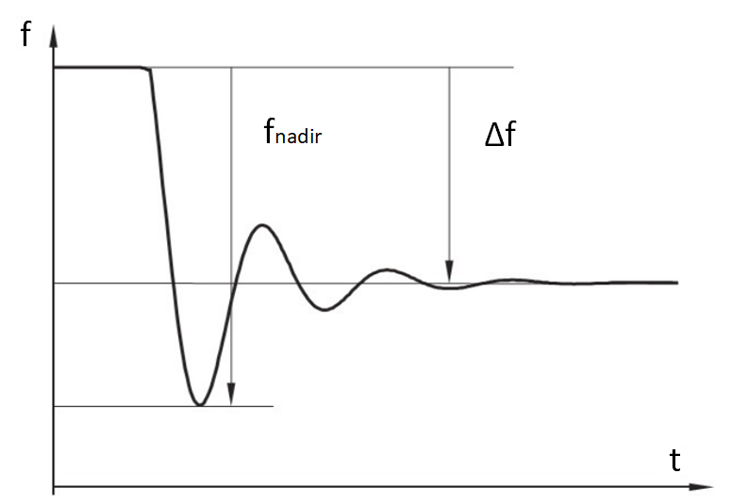
Frequeny Disturbance
Inertial Support
Until the primary controller action, the frequency falls.
Frequency decline is arrested by Inertial Support and Primary Frequency Controllers
Higher Grid Inertia → Lower RoCoF

Slide 9
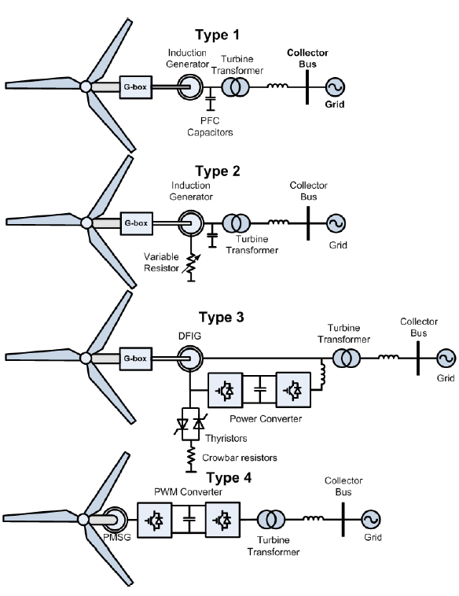
Renewable Energy Problems
The inertia in the wind turbine is not reflected to grid.
The increase in the share of RE causes the risk of frequency stability.
Existing structure decreases grid inertia!

Slide 10
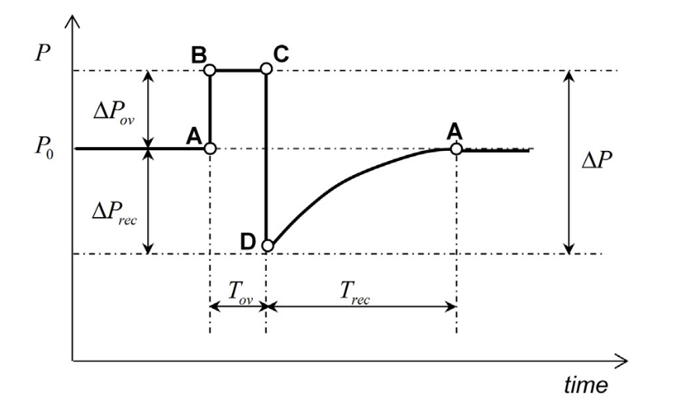
Renewable Energy Problems
The synchronous generators contribute grid inertia by injecting more power in the frequency disturbances.
The decrease in the grid inertia can be solved by emulating inertia support in the renewable energy systems.
Wind turbines with FSPC are the most promising type of renewable energy system due to its kinetic energy in the turbine inertia and the ability to control active/reactive power.

Slide 11
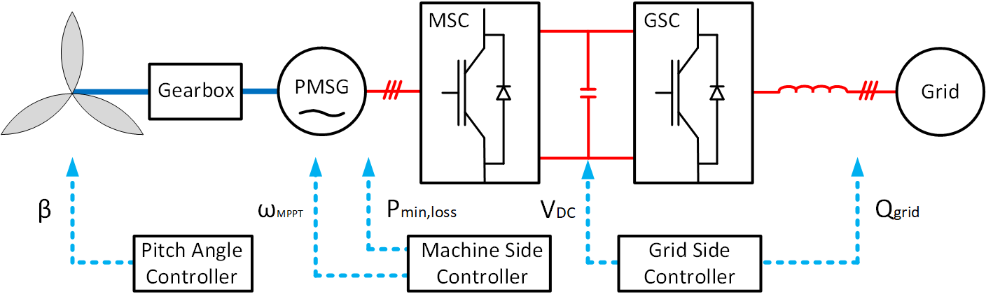
Wind Turbine Modelling
Notes:
Figure shows the modelling for the PMSG wind turbine that is connected to grid with FSPC. There are two converters in this type of the converter with different responsibilities. The one connected between DC-bus and grid is called Grid Side Converter and it is responsible for maintaining a constant DC-bus voltage and adjusting the reactive power that is injected to grid. The converter in between DC bus and PMSG is called Machine Side Controller. It is adjusts the generator and turbine speed to MPPT speed by controlling its output torque. When the output torque hits the limit, the speed cannot be regulated and exceeds the maximum allowable speeds. This is why Pitch angle controller is utilized. By increasing the pitch angle of the turbine, the aerodynamic power and aerodynamic torque is decreased. In this way, turbine speed is kept in the maximum in high speeds.

Slide 12
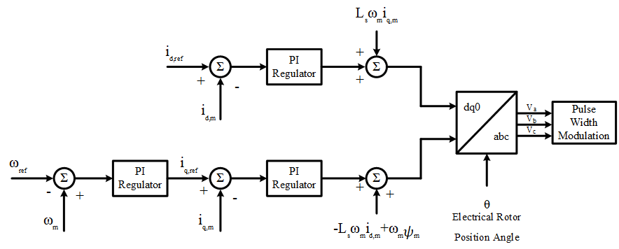
Wind Turbine Modelling

Slide 13
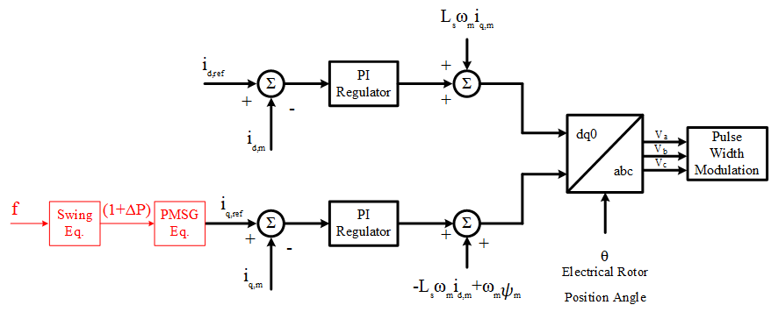
Wind Turbine Modelling
Notes:
In order to provide a inertial support, the wind turbine active power should be controlled. Therefore, the MPPT speed operation is leaved. The turbine torque is adjusted by controlling the q-axis current. The active power increase is either a defined percentage as in the case of fast inertial support or the active power increase according to Swing Equation.

Slide 14
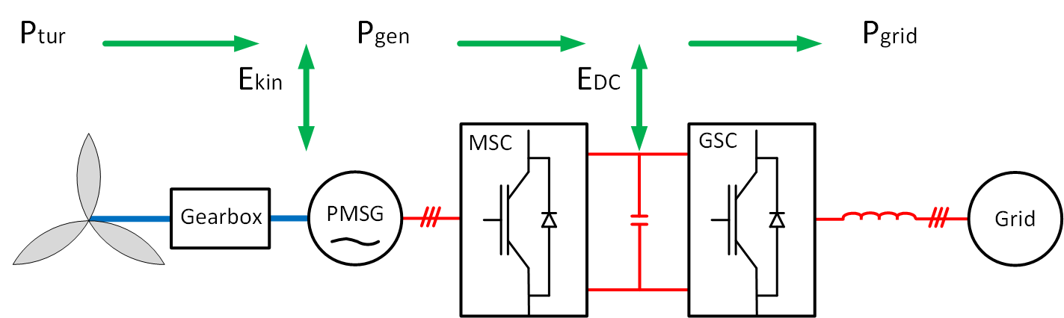
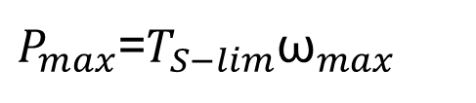
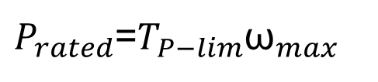
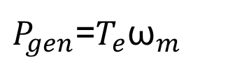
Fast Inertia Support
$P_{gen}$=$T_{e}{\text{ω}}_{m}$
$P_{rated}$=$T_{P−lim}{\text{ω}}_{max}$
$P_{max}$=$T_{S−lim}{\text{ω}}_{max}$

Slide 15
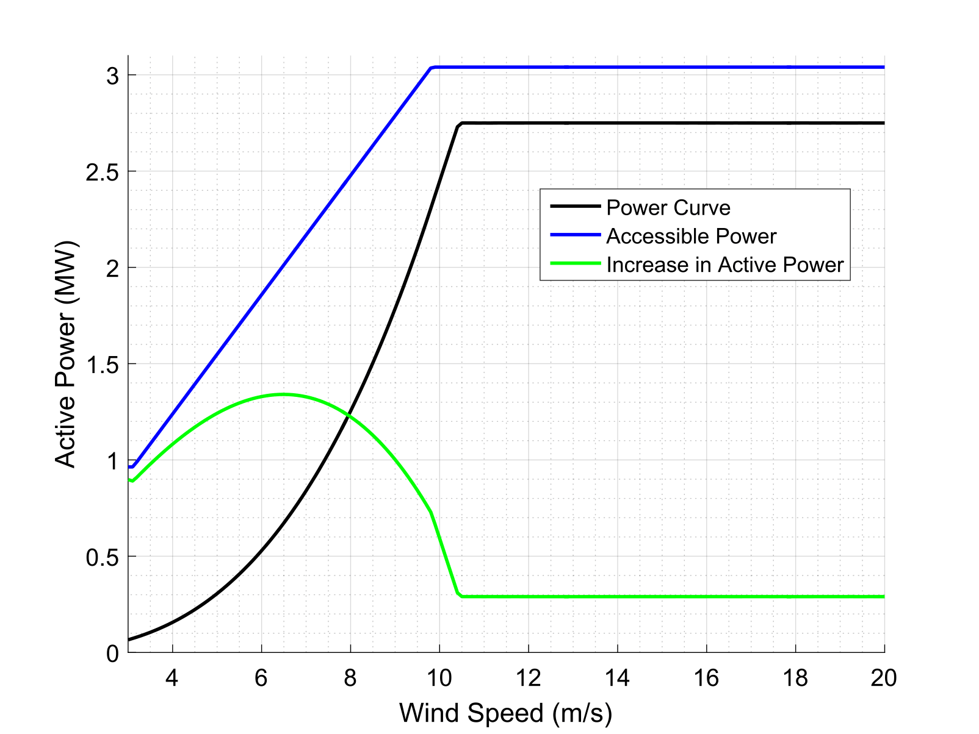
Fast Inertia Support
Notes:
Converter Limit

Slide 16
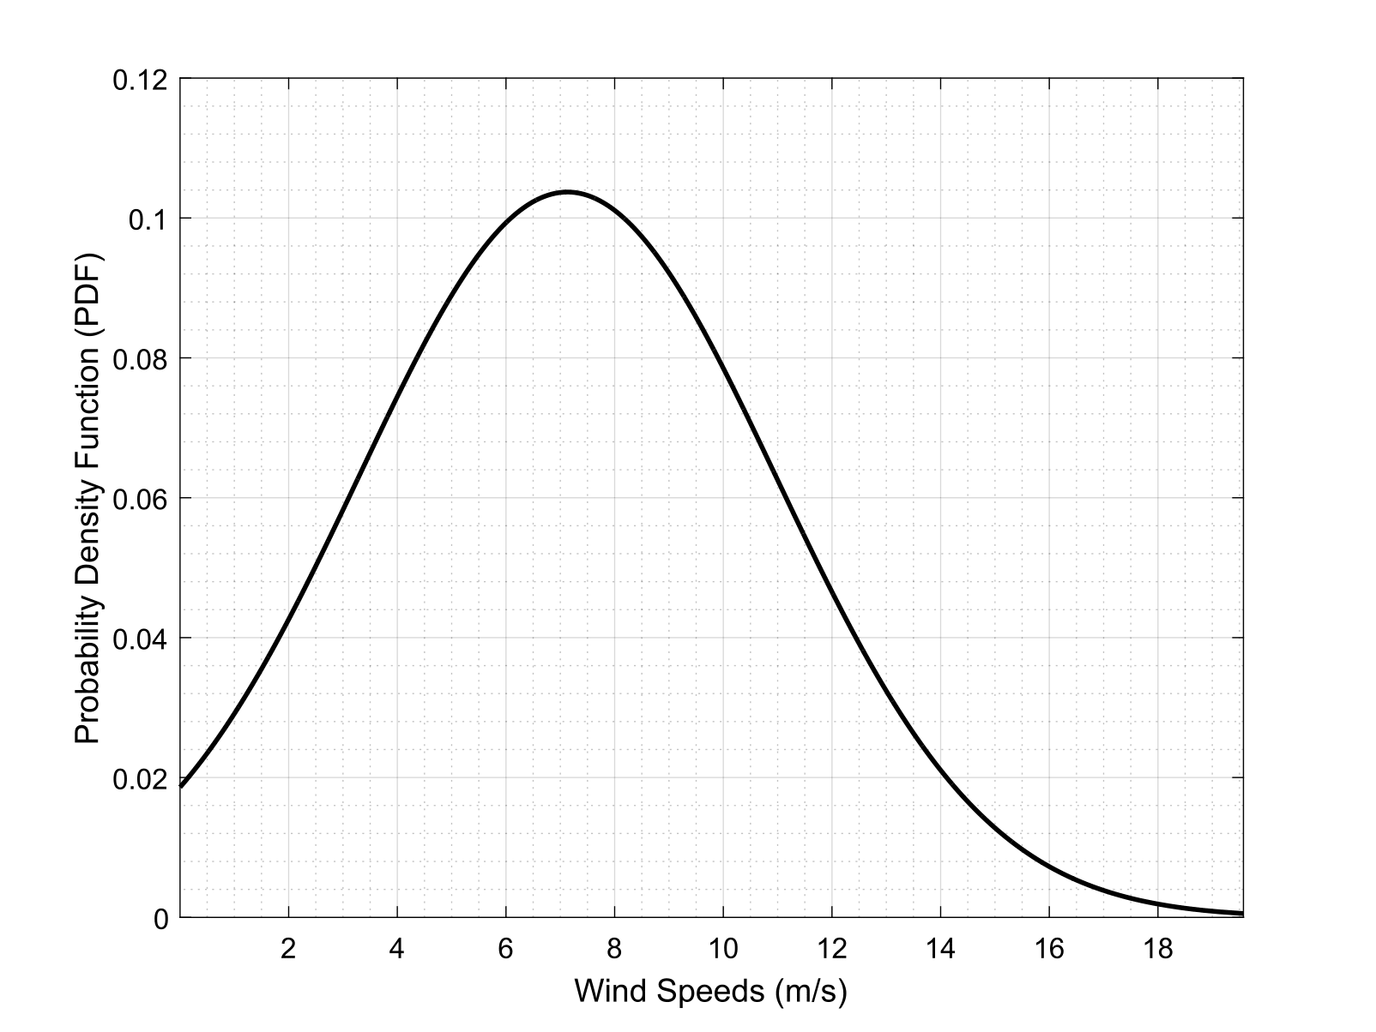
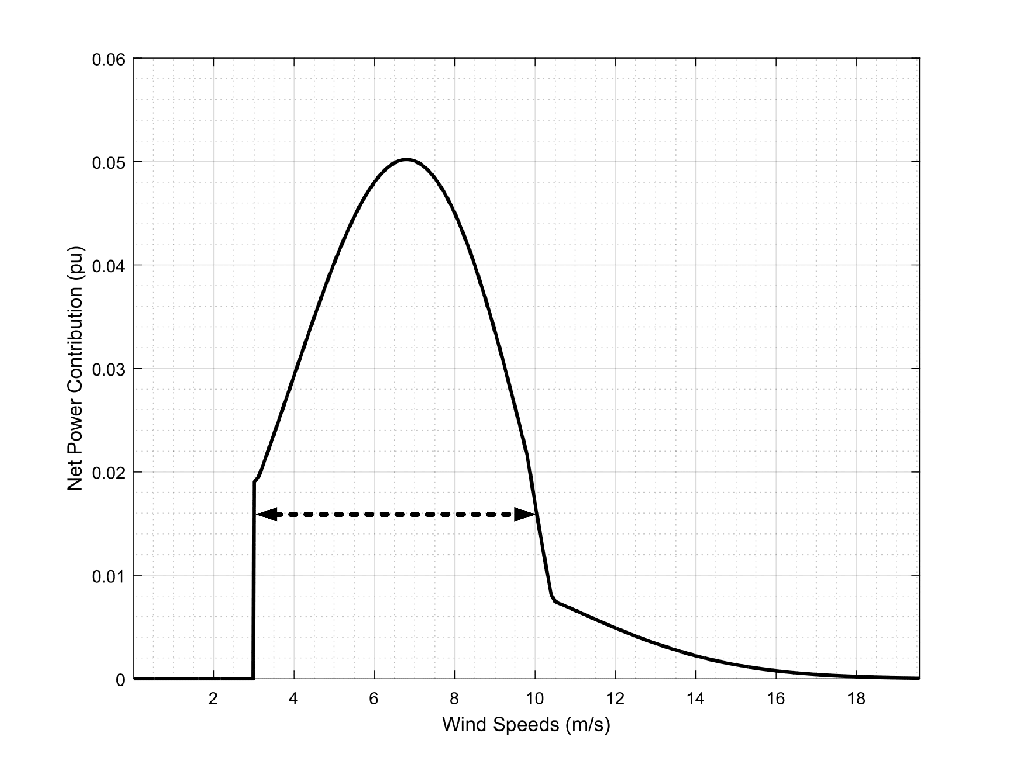
Fast Inertia Support
Notes:
Wind speed measurements used in this thesis are taken from a real wind farm with GE 2.75-103 model wind turbines between 01/01/2017 and 21/08/2017.
Main contribution of the wind turbine is in between the wind speed range of 3-10m/s.

Slide 17
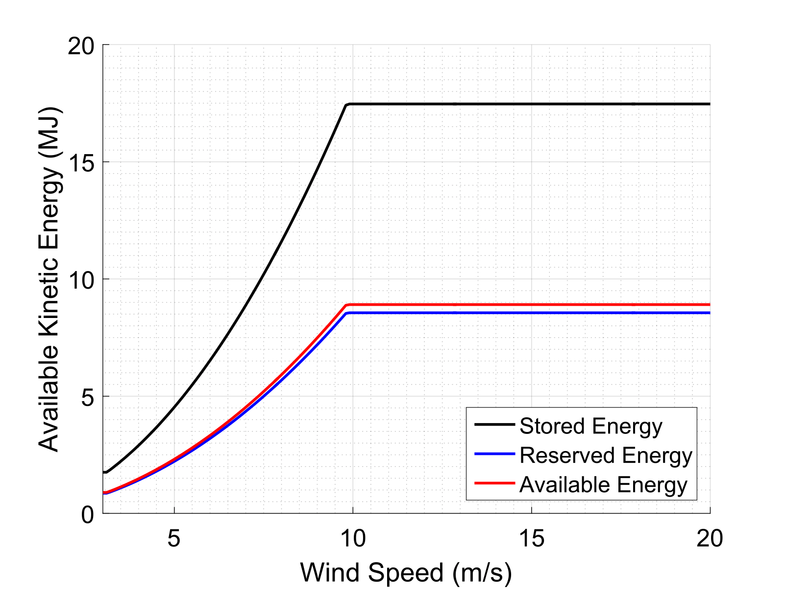
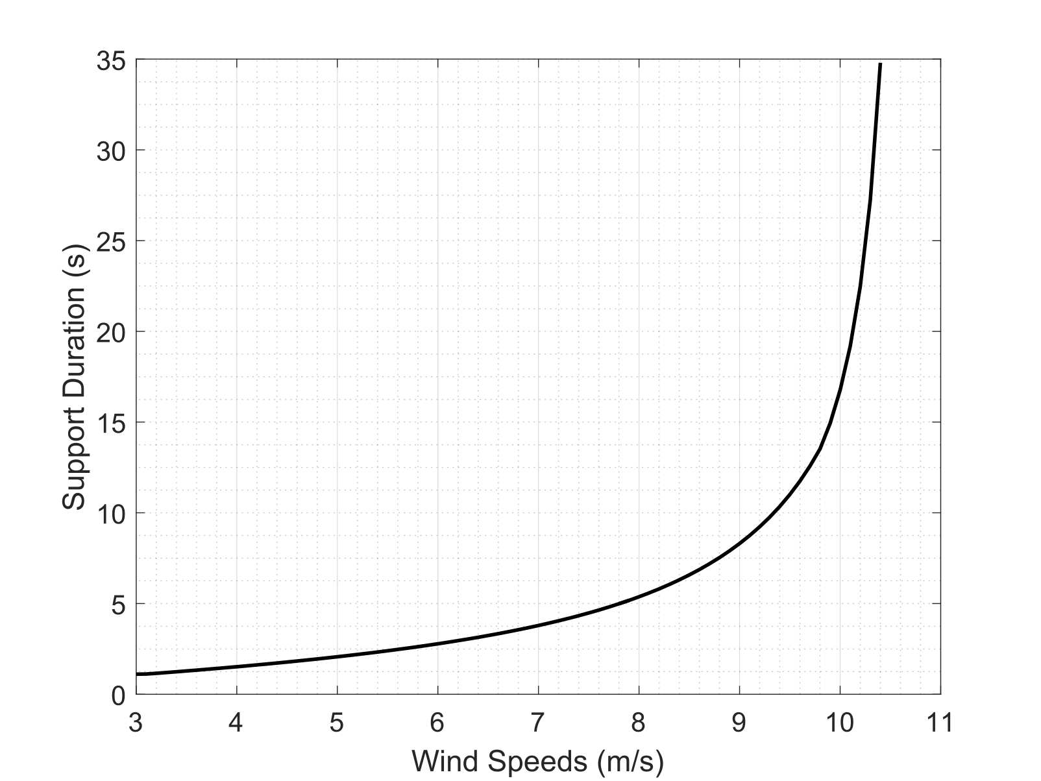
Fast Inertia Support
Notes:
Main contribution of the wind turbine is in between the wind speed range of 3-10m/s.

Slide 18
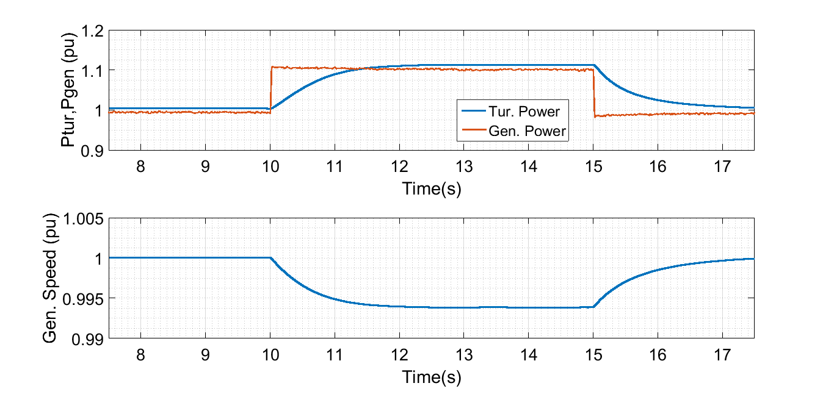
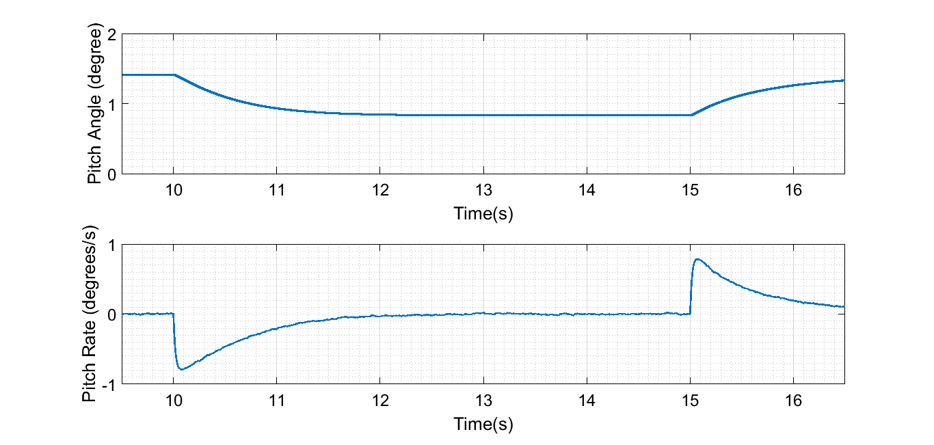
Fast Inertia Support
High Wind Speed Scenario
Notes:
High Wind Scenario.

Slide 19
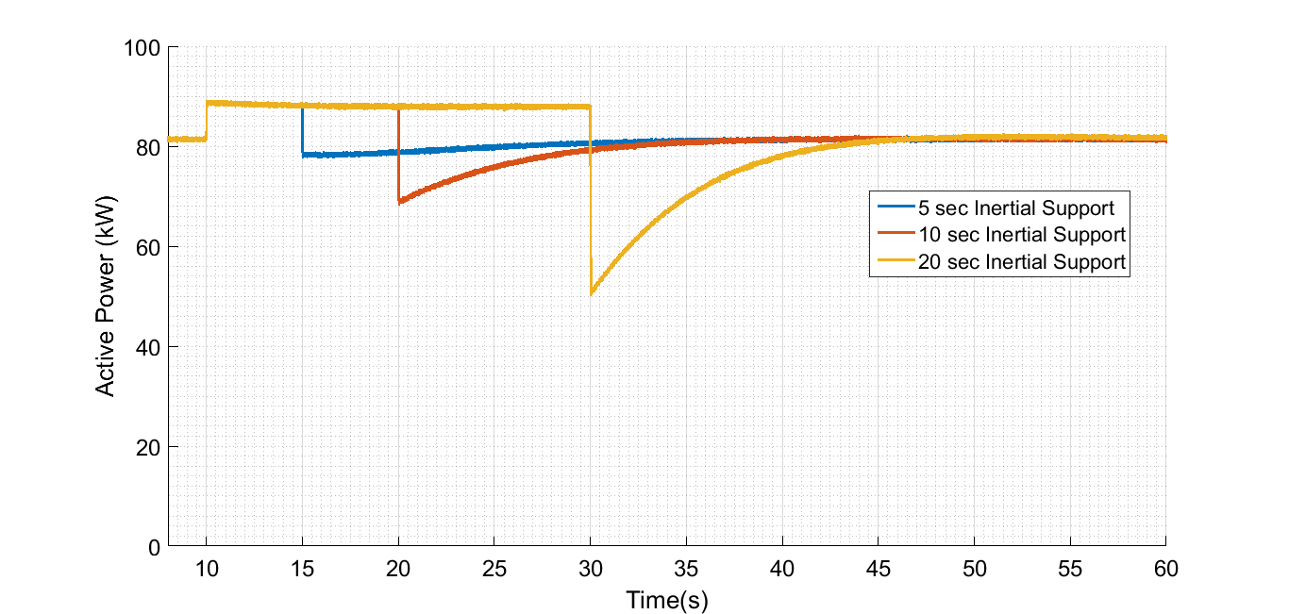
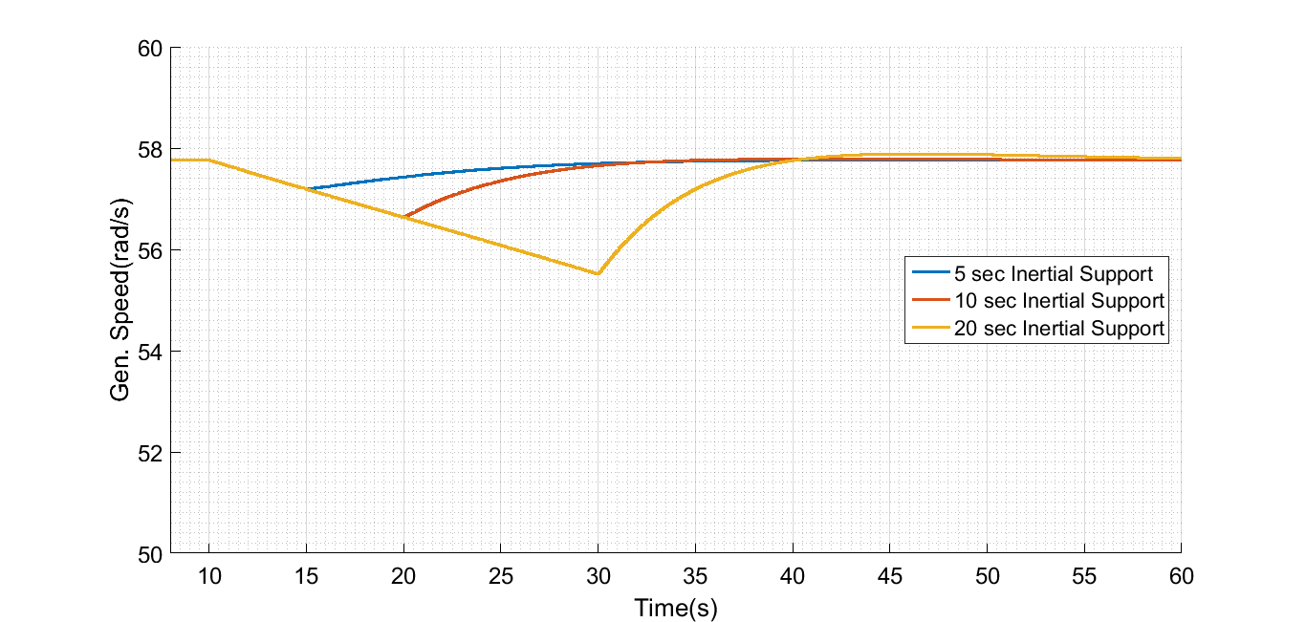
Fast Inertia Support
Low Wind Speed Scenario Moderate Case
Notes:
Low wind scenario.

Slide 20
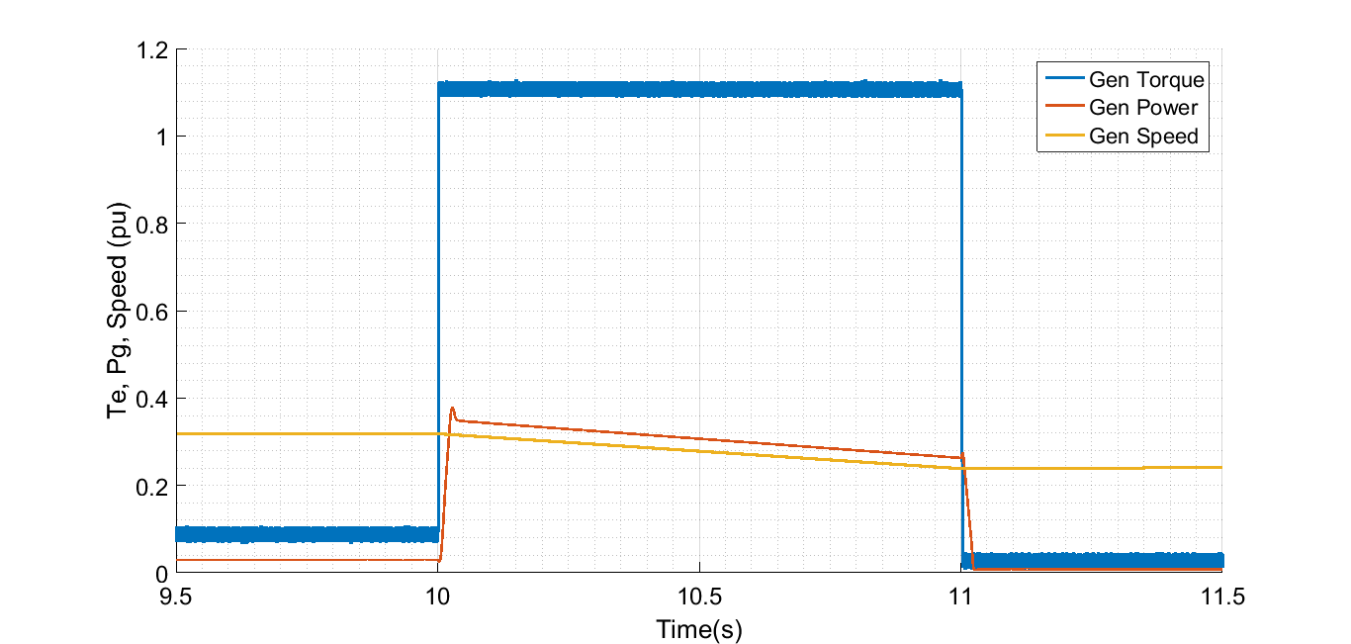
Fast Inertia Support
Low Wind Speed Scenario Limit Case Case
Notes:
Low wind scenario.

Slide 21
Fast Inertia Support
High Wind Speed Scenario
Notes:
High Wind Scenario.

Slide 22
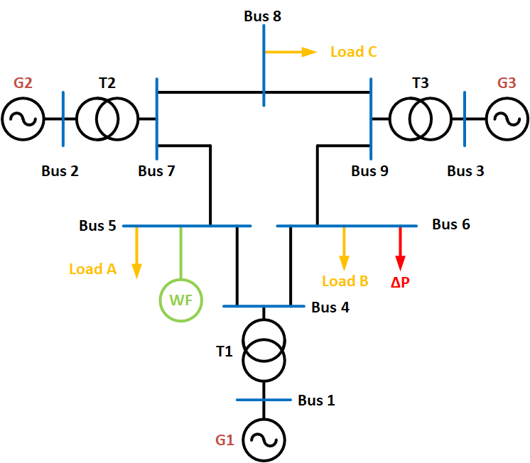
Implementation on a Test Case
Cases:
Base Case
10% Renewable Generation Case
Reduced Inertia Case

Slide 23
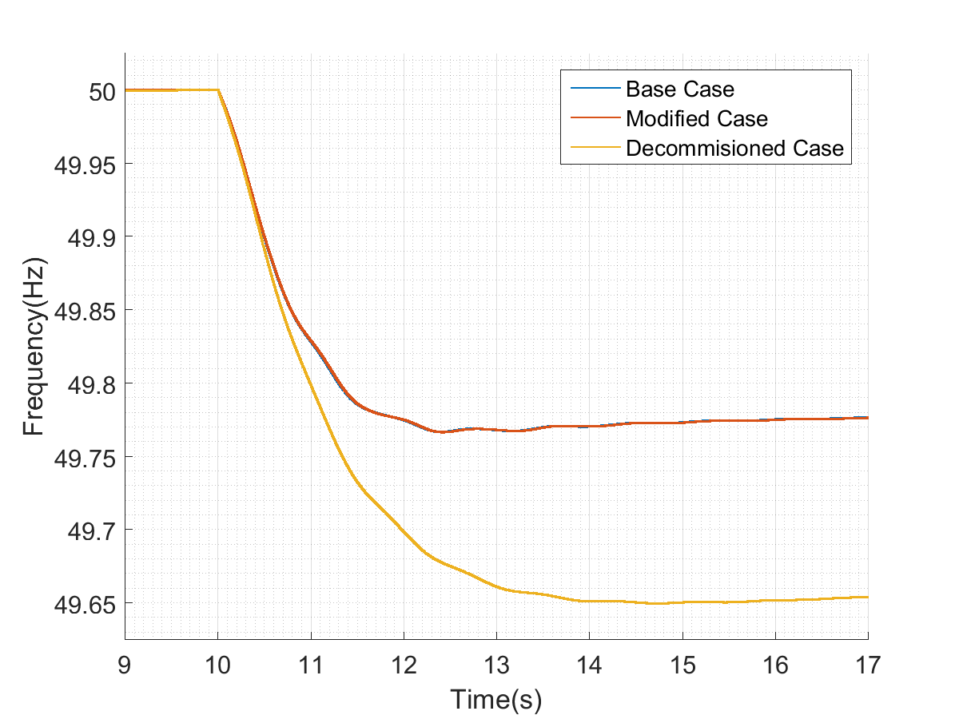
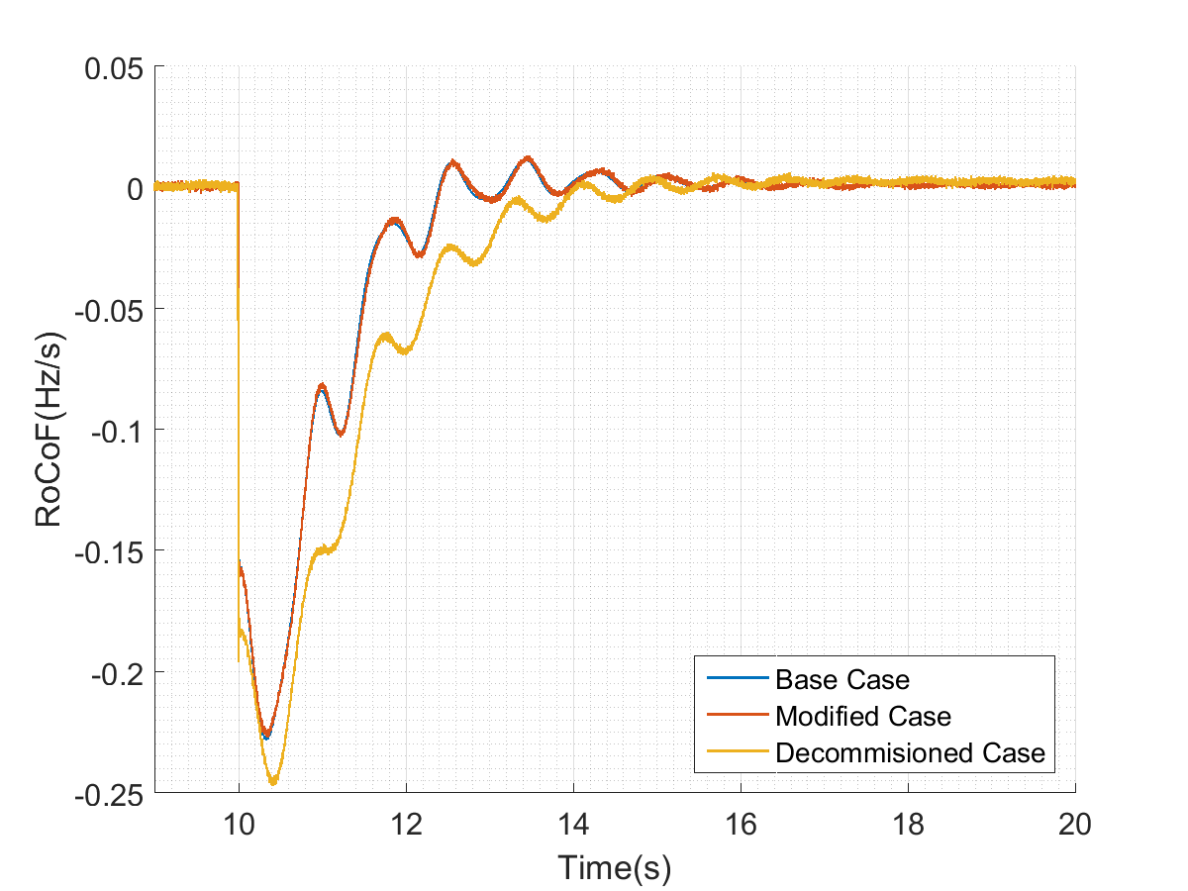
Implementation on a Test Case

Slide 24
Implementation on a Test Case
 | Without Synthetic Inertia Impelementation |  |  | With Synthetic Inertia (H=10s)
 | Base Case | 10% Renewable Case | Reduced Inertia Case | 10% Renewable Case | Reduced Inertia Case
Stored Energy (GJ) | 3.3 | 3.6 | 3.3 | 3.6 | 3.3
Effective Stored Energy (GJ) | 3.3 | 3.3 | 3 | 3.9 | 3.6
Maximum RoCoF (Hz/s) | 0.23 | 0.23 | 0.25 | 0.19 | 0.21
Frequency Nadir (Hz) | 49.77 | 49.77 | 49.65 | 49.77 | 49.65

Slide 25
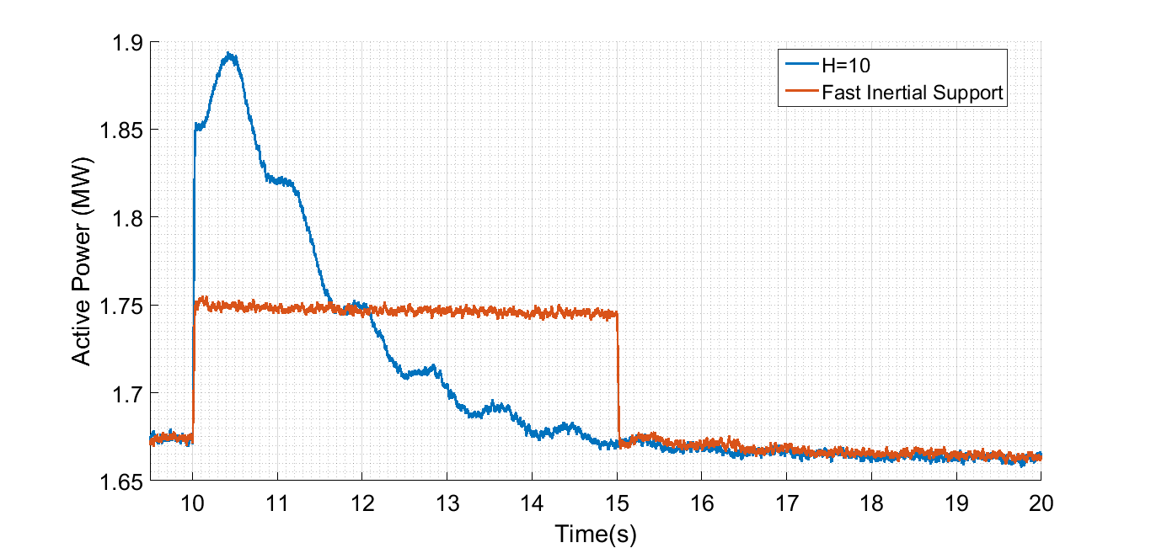
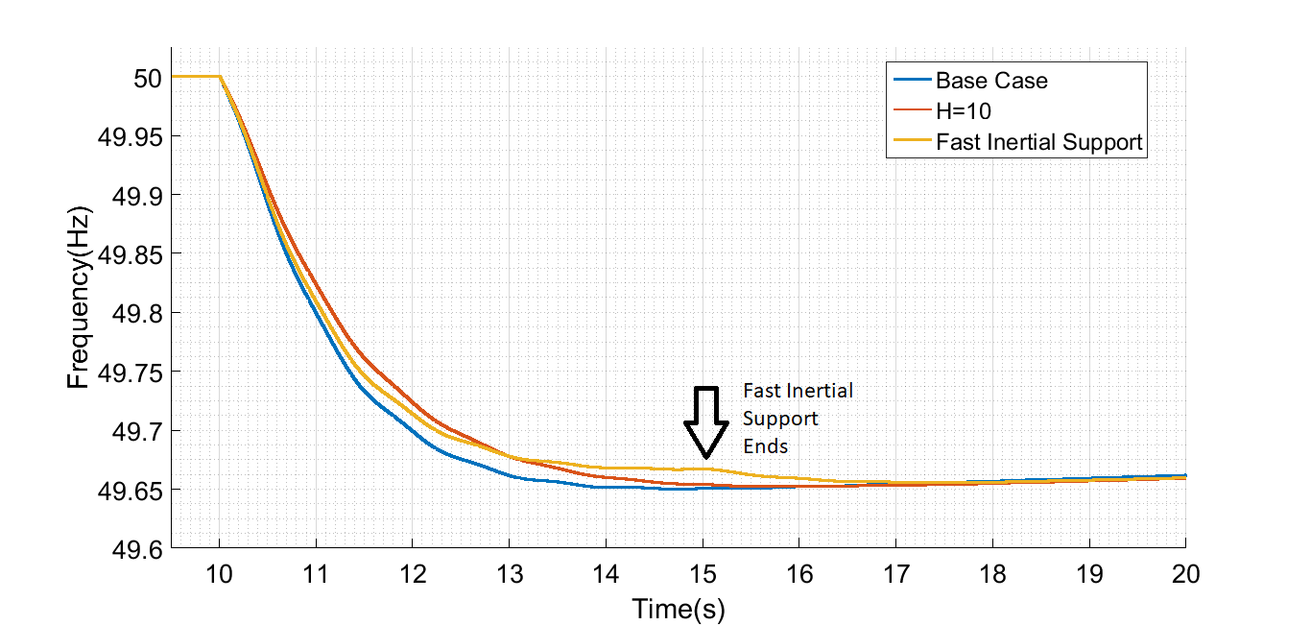
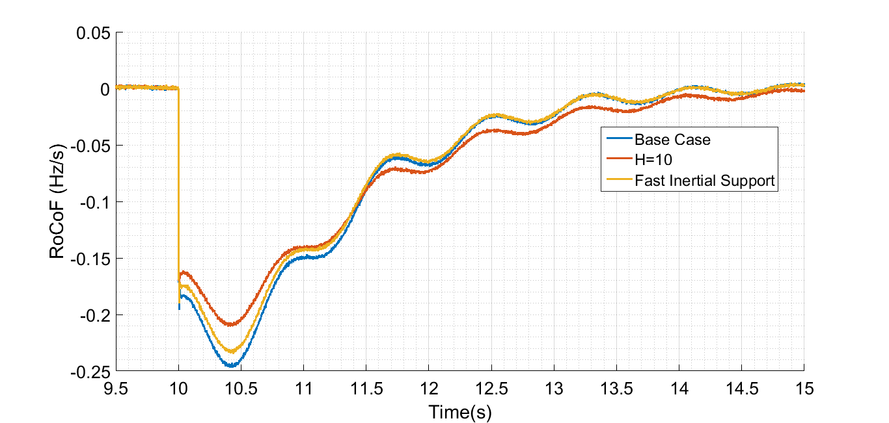
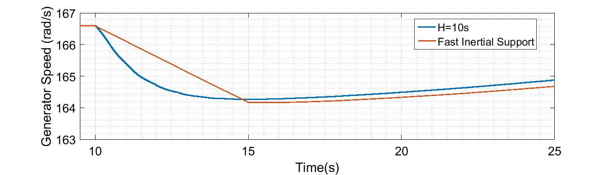
Comparison between Fast Inertial Support and Synthetic Inertia

Slide 26
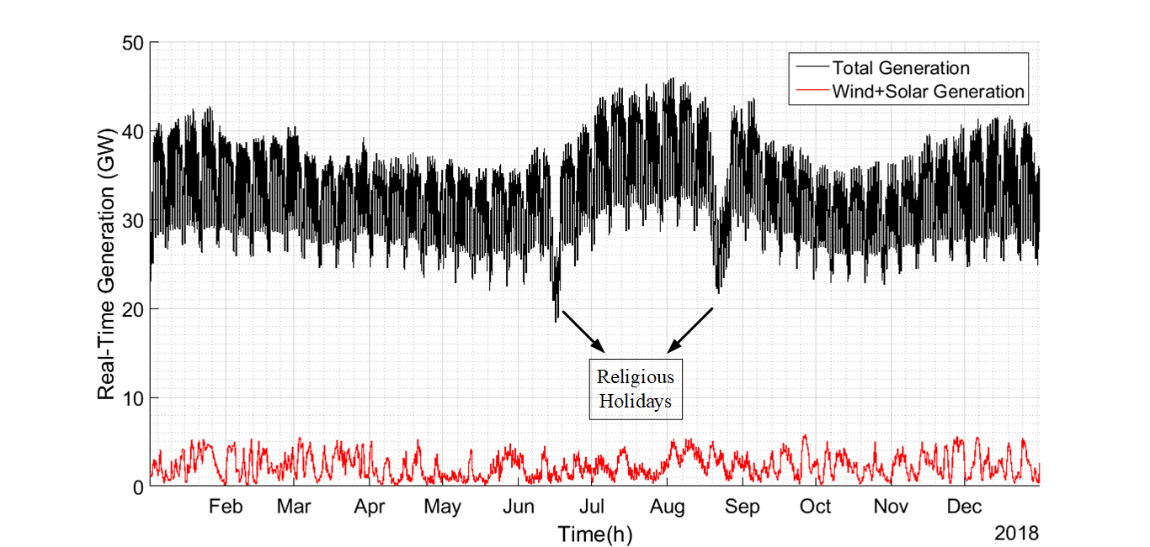
Effects on the Turkish Electricity System
Notes:
In order to investigate the effect of the synthetic inertia implementation, the 2018 generation data has been used. In the figure, black line shows the variation of the generation meanwhile the red line shows the generation of wind + solar energy. The maximum generation occured in the 3th of August with a generation of 46GW. The minimum of the load has occured in a religious holiday on the 16th of July with a generation of 18GW.
The generation data can be used to roughly estimate the aggregated inertia constant in the grid.
As stated before, the effective inertia contribution from wind and solar systems are zero. Moreover, the inertia constants of the synchronous generators vary between 2-9. By using zero inertia constant for wind and solar, H=5s for others, the effective inertia constant can be calculated.s

Slide 27
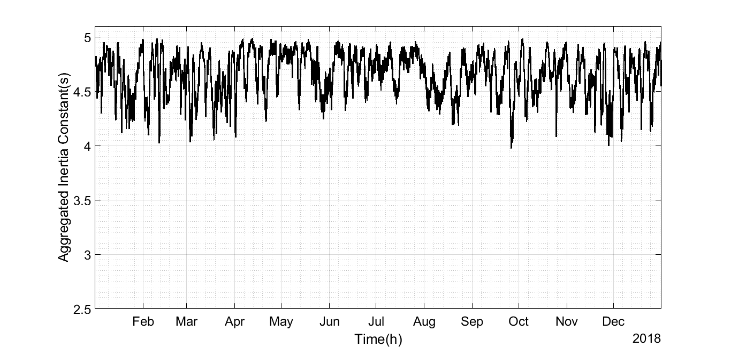
Effects on the Turkish Electricity System
The aggregated inertia constant can be improved with synthetic inertia implementation.
Notes:
The effective aggregated inertia in the system is shown in the graph. Notice that the inertia constant decreases down to 3.97s when the 20% of the generation is supplied from wind and solar in 26/09/2019 on 3 pm.
It is possible to improve the effective inertia constant of the grid with synthetic inertia implementation. Note that the 54% of the installed wind energy systems in Turkey has FSPC. By assuming that 54% of wind energy production is obtained from these wind turbines and implementin inertia constant of h=10s, the improvement can be calculated.
When the method is implemented on the wind turbines with FSPCs,

Slide 28
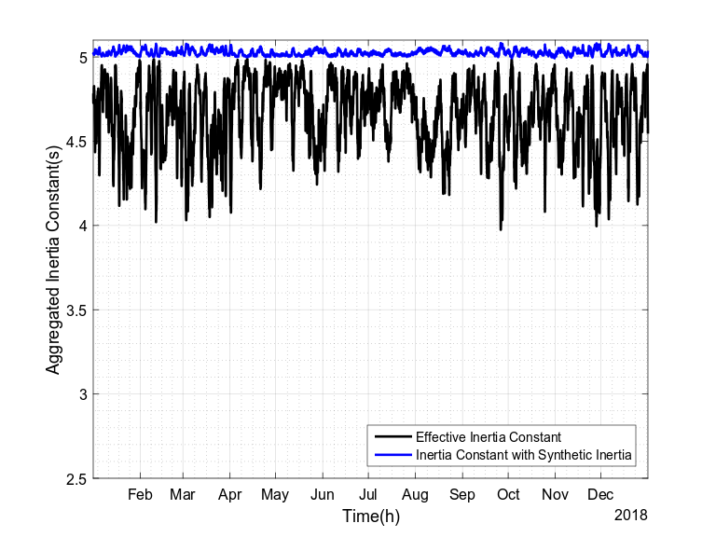
Effects on the Turkish Electricity System
Date | 26/09/2018
Hour | 03:00:00
Total Generation (MW) | 27495
Wind (FSPC) (MW) | 3045
Wind (Other) (MW) | 2594
Solar (MW) | 0
Other (MW) | 21773
Existing Case | H=3.97s
With Synthetic Inertia (H=10) | H=5.08s
Notes:
The existing inertia constant and inertia constant with synthetic inertia is shown in the figure. Notice that the inertia constant is above the H=5s. That means the wind turbines can compensate the decrease in the inertia constant caused by them and also caused by solar energy. Note that the inertia constant is maximum where the existings case inertia constant is minimum.

Slide 29
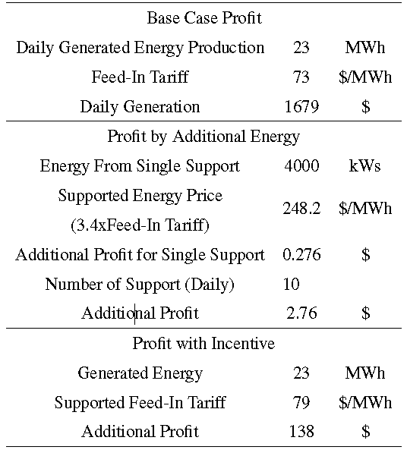
Economical Perspective

Slide 30
Economical Perspective
Net additional energy is zero! (There exists losses due to deviation from MPPT, inside the gearbox, converter etc.)
Let us only pay for the increased period (neglect the decrease):
A single support profit: $0.276 vs Daily Generation=$1679
Not possible with additional energy!
Incentives might convince the energy provider since it creates a significant rise on the profit (8.2% increase with 0.3¢/kWh).
Incentives will end at the end of 2020 for the new generation renewable energy systems. A new incentive might be inertial support from renewable energy systems!

Slide 31
Conclusions
Renewable energy systems should possess the inertial support capability to avoid the reduction in the grid inertia.
Inertial support capability of wind turbines with FSPC is limited with 10% in high wind speeds. Maximum increase occurs in 6.5m/s with 48% increase. Average contribution is 30%.
Wind turbine can emulate the inertia constant H=10s for the whole speed range.
Grid stored kinetic energy can be improved by 8% with the synthetic inertia implementation.
Energy providers cannot be convinced with solutions based on the additional payments but methods based on additional incentives.

Slide 32
References

